Slide 1
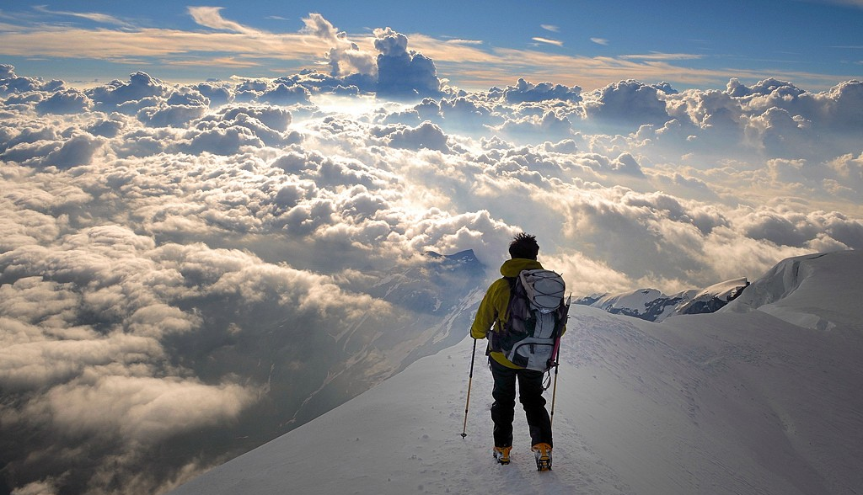


Containerization

Slide 3
The Cloud Native Stack
Cloud Native App Platform
Services
Classical Applications
Cluster Orchestrator
Applications
Cluster Scheduler
Container
Virtualization
Resources

Slide 4
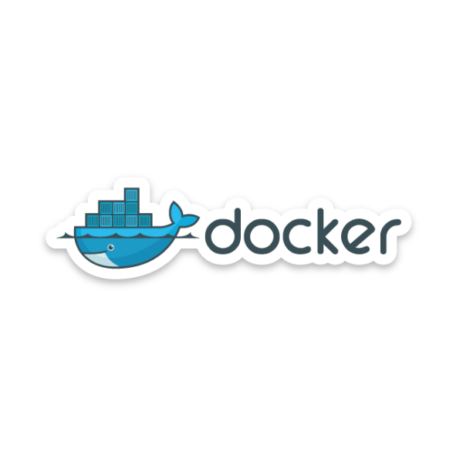
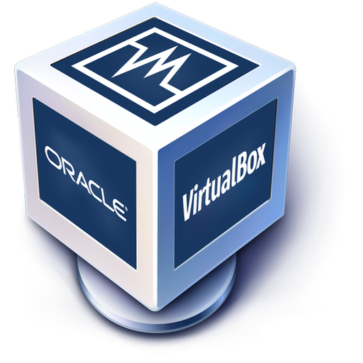
Hardware vs. OS Virtualization
*) HSI = Hardware Software Interface
SCI = System Call Interface
Hardware Virtualization
OS Virtualization
Isolated Hardware
Isolated NW-interface, process space, file system
Application
Application
Container
OS Libraries
Private Copy
OS Libraries
Virtual Machine
SCI*
OS
OS
Virtual Hardware
(Virtual Hardware)
HSI*
Shared Resources
Real Hardware
Real Hardware
Stronger Isolation
Less volume of private copy
Near zero runtime overhead (RAM, CPU)
Short start-up time (~ time to lauch a process)
Notes:
Speed - instead of minutes, it's probably 2-3 seconds
Soft Memory - allocating applications in memory rather than disks
Minimal Footprint - instead of thousands of MBs, it's tens of MBs
Can Run Many - like literally 100 containers could be run in parallel on a single box
Resilience - when you have a crash, you can relaunch immediately
Security - if one container gets DDOS kinda attack, others won't get effected
Snapshots - using union file-systems
http://isagoksu.com/2014/what-is-docker-what-makes-it-different-from-vms/
Aktuell ist das SCI bei Linux ca. 380 System Calls breit

Slide 5
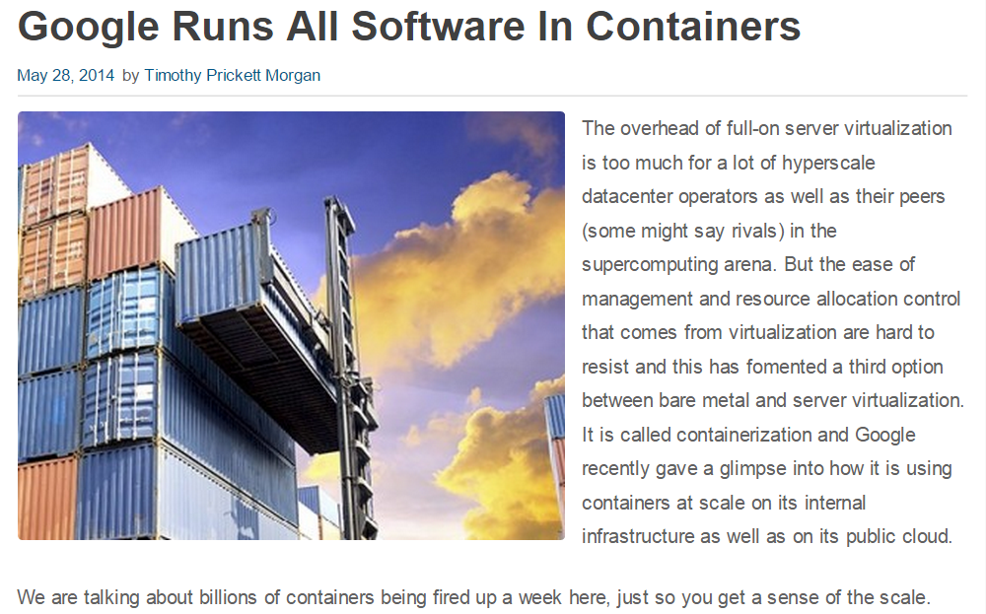
Docker Basics
http://www.enterprisetech.com/2014/05/28/google-runs-software-containers

Slide 6
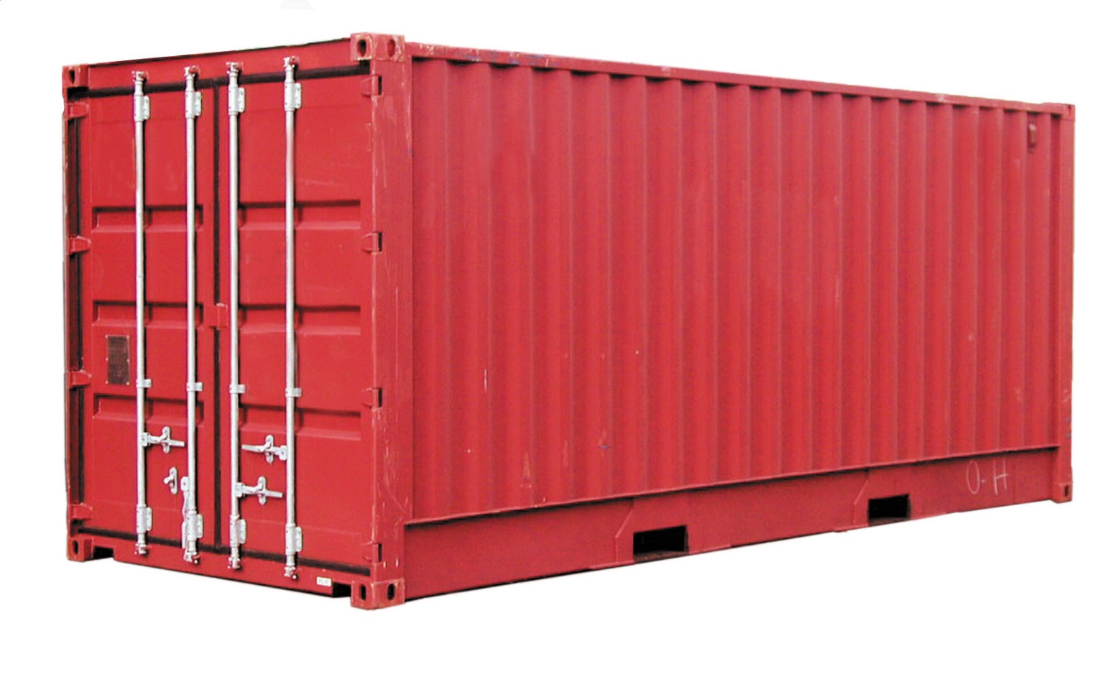
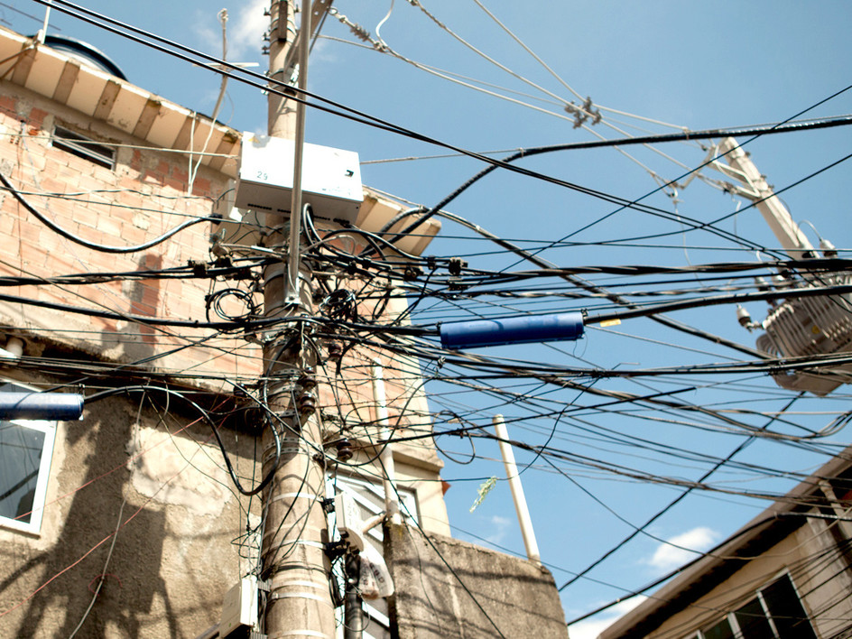
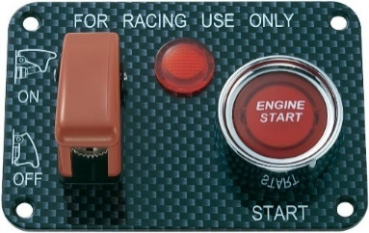
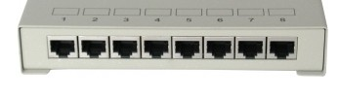
Containerization with Docker
My
App
http://www.srf.ch/kultur/im-fokus/brasilien/favelas-im-wandel-die-armen-muessen-weichen
Standard format for operations (start, stop, configure, wire, debug, …) and software logistics.

Slide 7
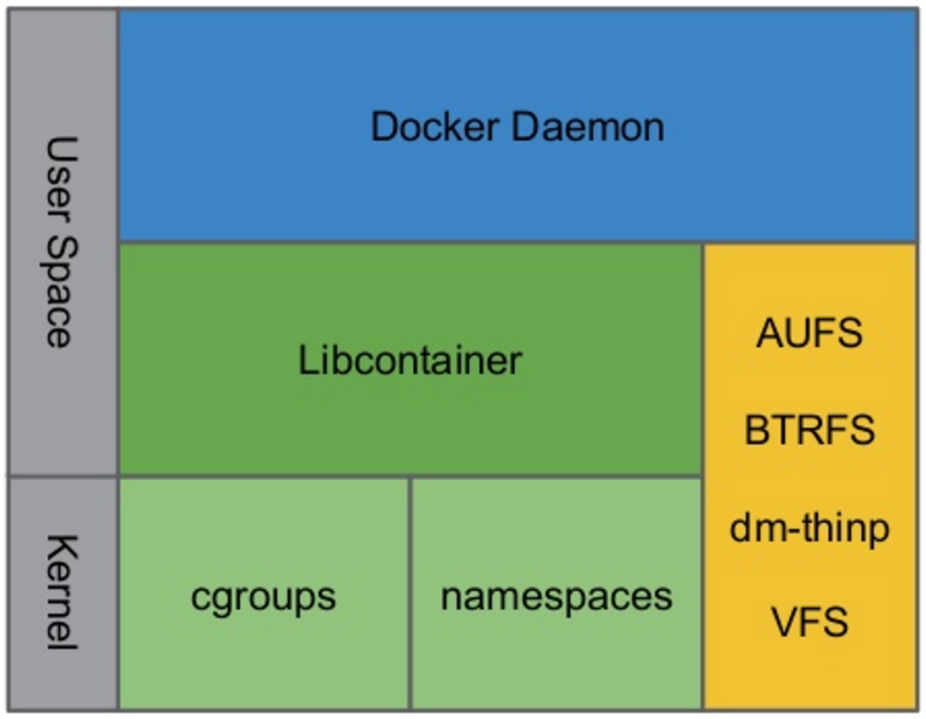
Docker: Building Blocks
Containerization
Docker currently supports Libcontainer, LXC and OCI
(https://www.opencontainers.org)
Union File Systems
Modifications are stored in seperate layers
Layers are unified to one consistent FS view
Isolation

Slide 8
Docker: Images and Containers
Images
Container
Union Filesystem
Container State
read / write
Derived Images <I1>
Layer:
commit
Filesystem
Configuration
read only
Base Image (e.g. Ubuntu)
run
Distro libs + files
Filesystem
Configuration
Container Information
Entrypoint Process
Resting and transportable
Docker only fetches layers it
does not have local
Running
Container runs as long as the entrypoint process runs in foreground
Notes:
Im Zentrum von Docker stehen Images und Container:
Image = Ordner/Dateien mit App, Libs etc. Ein Image basiert i.d.R. auf einem anderen Image und speichert nur das Delta zu diesem Image. Ausnahme: Das Base-Image.
Container = Image-Kette + Laufzeit-Zustand. Ein Container lebt nur so lange, wie der erste Prozess läuft, der darin gestartet wurde. Bei mehreren Prozessen nutzt man i.d.R. http://supervisord.org als ersten Prozess.

Slide 9
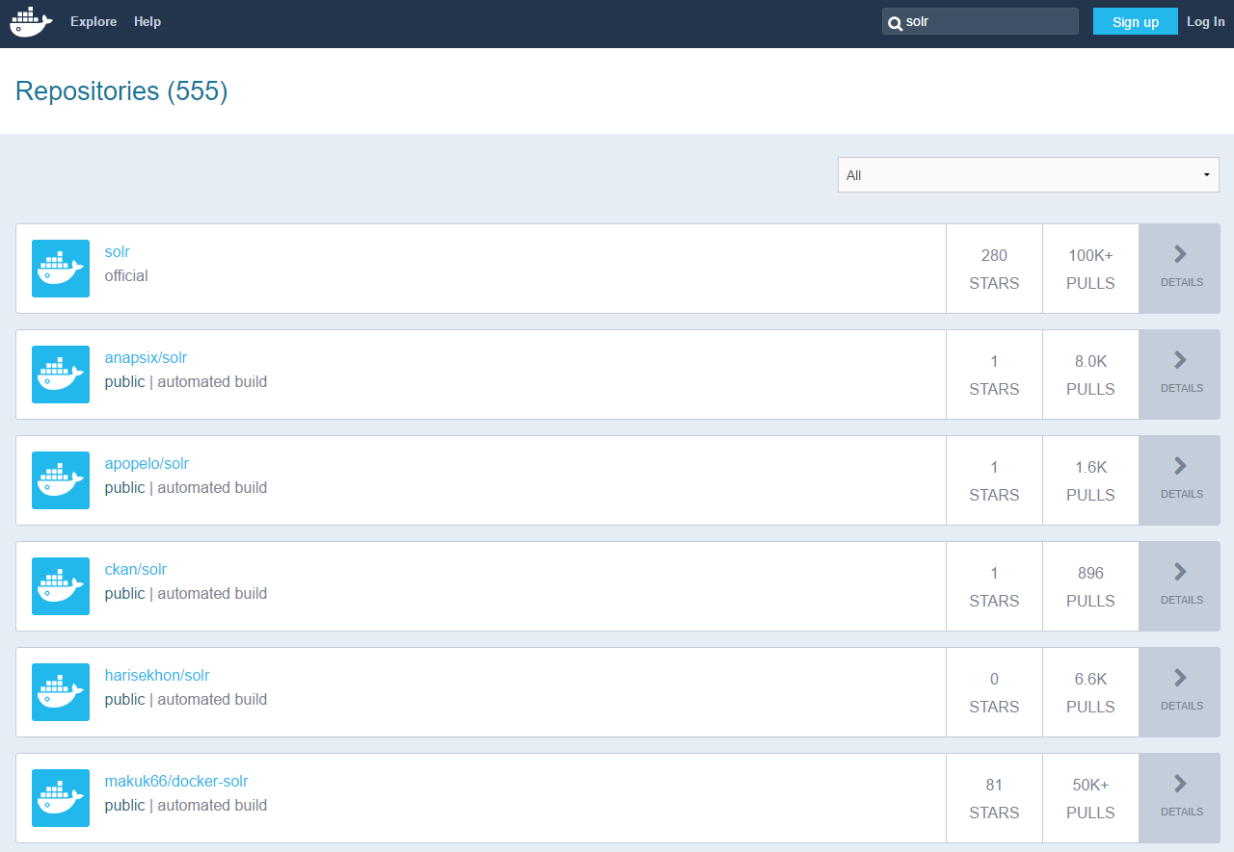
hub.docker.com is the Public Repository for Docker Images

Slide 10
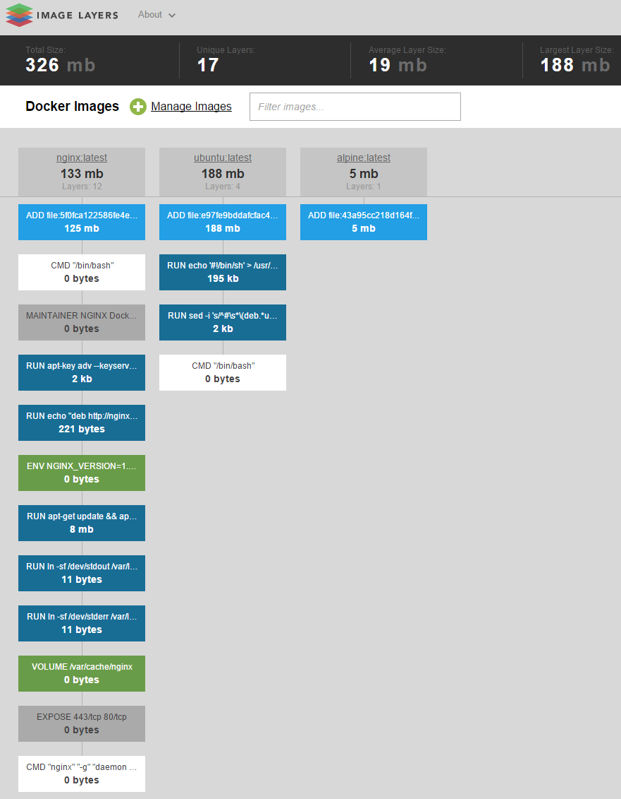
Visualizing Image Layers with imagelayers.io
Bildquelle: https://imagelayers.io

Slide 11
Docker Architecture

Slide 12
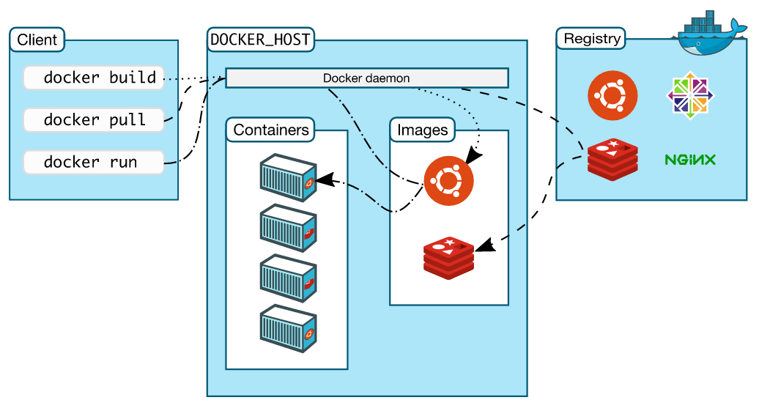
Command line tool using socket connection to docker daemon
Any client using docker daemon REST API
Public registries like Docker Hub or Quay.io
Private registries like Artifactory, Nexus or Docker Registry
The Docker daemon is the central control plane of Docker and runs as
process within the host operating system.
The Docker daemon manages all local images and containers on one host.
Source: http://docs.docker.com/engine/introduction/understanding-docker

Slide 13
Docker Workflow

Slide 14
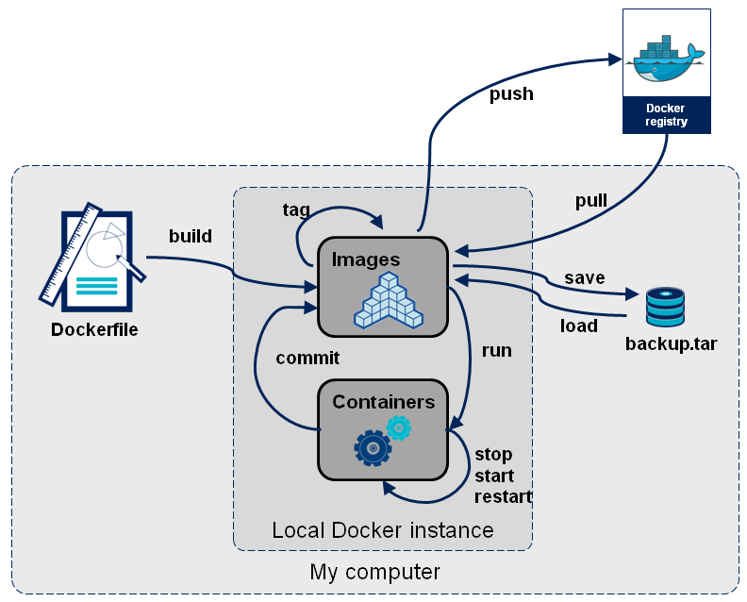
Docker Workflow Overview

Slide 15
A Typical Workflow
Images:
busybox: Mini OS (2MB) for testing purposes
alpine: Mini OS (5MB) with package mgr.
ubuntu: Maxi OS (188MB)
Command | Action
docker images | Prints all local images
docker run –d –v <volume mounts> -p <host-port>:<container-port> <image> <entrypoint process> | Run a Docker image: Creates and runs a container. in background with host directory mounted into the container with port forwarding from Host to Container image name and entrypoint process
docker run –ti <image> /bin/sh | Run a Docker image and open a shell within the container … with forwarding of local terminal Image name and shell (or „/bin/bash“)
docker ps -a | Prints all containers (without –a = only running containers)
docker commit <container> qaware/foo | Store container as local image
docker kill <container> docker rm <container> | Terminate container (send SIGKILL to entrypoint process) Remove container
docker rmi –f <image> | Remove local image
More commands: https://coderwall.com/p/2es5jw/docker-cheat-sheet-with-examples, https://docs.docker.com/reference

Slide 16

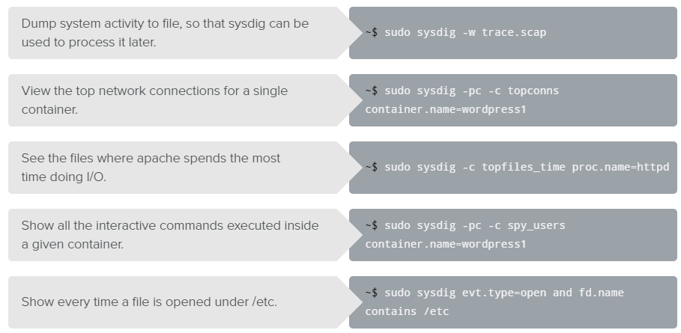
Container Troubleshooting
Command | Action
docker inspect <container> | Shows container metadata (e.g. IP)
docker logs <container> | Prints container syslog
docker top <container> | Prints all running processes within a container (like ps –a within the container)
docker exec –ti <container> /bin/sh | Connect terminal to running container
docker stats | Shows container runtime statistics (e.g. CPU usage, IO intensity, …)
Ultima ratio:

Slide 17
Writing Dockerfiles

Slide 18
Building Images with a Dockerfile
A Dockerfile is used to build a new Image.
A Dockerfile creates a new Image on the basis of another Image. Therefore the following actions are automated:
Configuration of the Images and the resulting Container
Executing actions for Provisioning
A Dockerfile is a representation of an Image, not a physical image (Construction manual vs. Construction part).
Repeatability in the building of Containers
Automatic creation of images without distributing them
Flexibility in configuration and software-versions
Simple syntax, easy to use

Slide 19
A Dockerfile can be Used to Build an Image
FROM ubuntu
MAINTAINER Josef Adersberger, jad@qaware.de
RUN apt-get update
RUN apt-get --assume-yes install nginx
ADD https://provisoning.server.de/nginx.conf /etc/nginx/nginx.conf
ENTRYPOINT [nginx]
EXPOSE 80
docker build –t <ziel_image_name> <Dockerfile>

Slide 20
Dockerfile Commands
Element | Meaning
FROM <image-name> | Sets to base image (where the new image is derived from)
MAINTAINER <author> | Document author
RUN <command> | Execute a shell command and commit the result as a new image layer (!)
ADD <src> <dest> | Copy a file into the containers. <src> can also be an URL. If <src> refers to a TAR-file, then this file automatically gets un-tared.
VOLUME <container-dir> <host-dir> | Mounts a host directory into the container.
ENV <key> <value> | Sets an environment variable. This environment variable can be overwritten at container start with the –e command line parameter of docker run.
ENTRYPOINT <command> | The process to be started at container startup
CMD <command> | Parameters to the entrypoint process if no parameters are passed with docker run
WORKDIR <dir> | Sets the working dir for all following commands
EXPOSE <port> | Informs Docker that a container listens on a specific port and this port should be exposed to other containers
USER <name> | Sets the user for all container commands
see: http://docs.docker.com/engine/reference/builder

Slide 21

Unit Testing Containers
http://serverspec.org
?
require 'spec_helper'
describe "nginx" do
describe "check running" do
describe process('nginx') do
it { should be_running }
end
describe port(80) do
it { should be_listening }
end
end
describe file('/etc/logrotate.d/nginx') do
it { should be_file }
it { should contain "rotate 14" }
end
end
gem install serverspec
serverspec-init

Slide 22
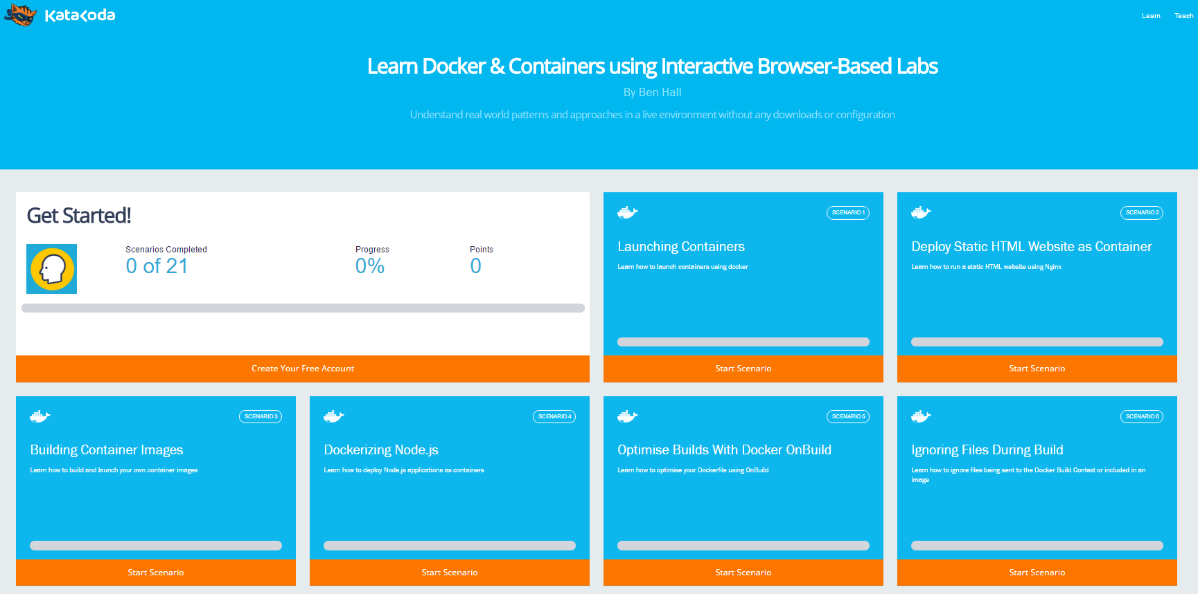
Katacoda: A Guided Training Environment for Docker.
https://katacoda.com/courses/docker

Slide 23
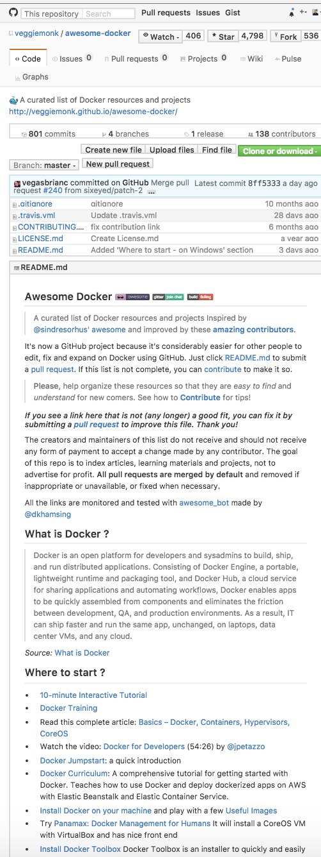
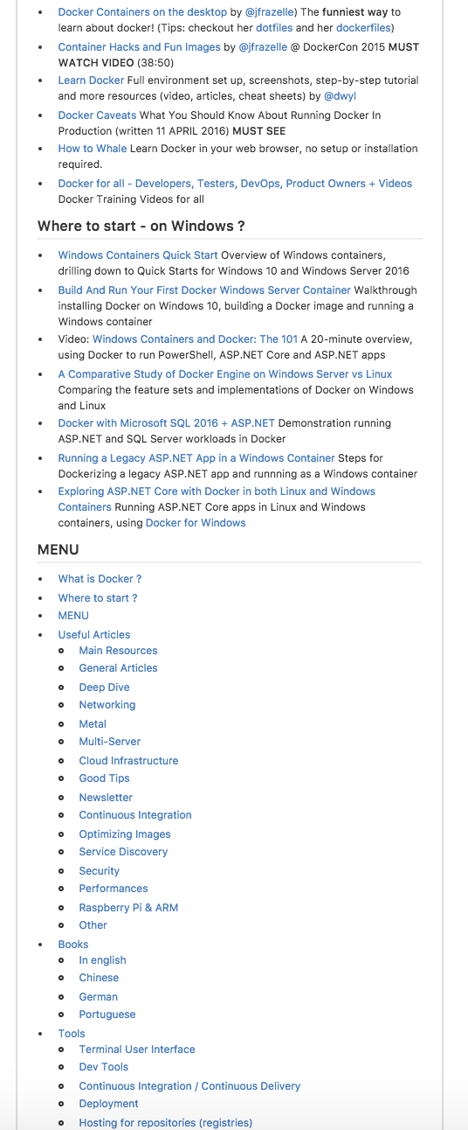
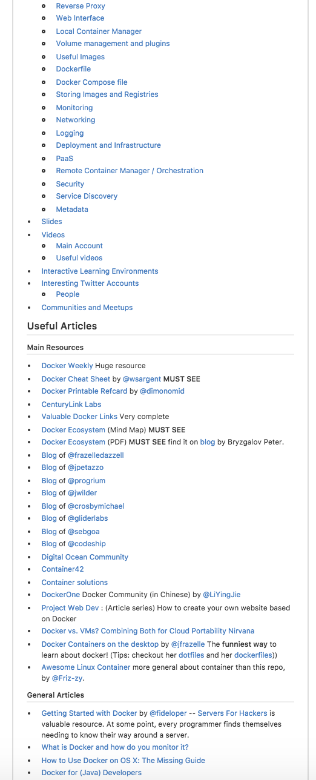
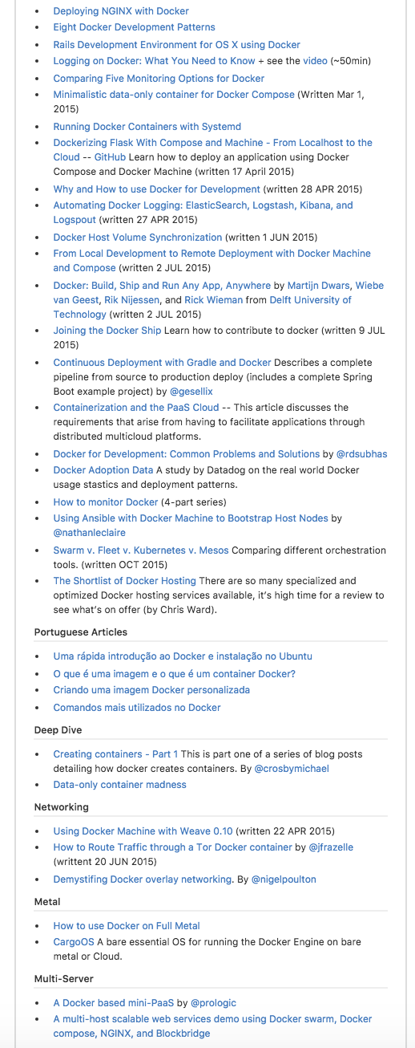
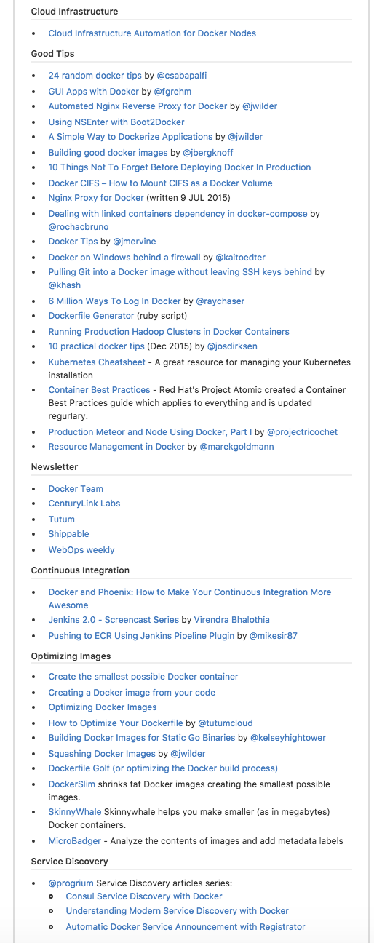
https://github.com/veggiemonk/awesome-docker
…

Slide 24
Docker Best Practices

Slide 25
List of Best Practices
A Docker-Build must be repeatable
Concatenate associated commands in the `RUN` command
Remove temporary files
Publish important Ports with `EXPOSE`
Define Environment Variables
One Image for all Environments
Only one image per Version in Docker-Registry
Environment configuration with Environment variables, Configuration files per volume

Slide 26
A Docker Build must be repeatable
A build at a later time must produce an identical image
Keep care with versions
All files for the image are stored in the repository of the Dockerfile
No LATEST Tag, use explicit versions instead
Define always a version when installing a Software
RUN apt-get update && apt-get install -y ruby1.9.1

Slide 27
Concatenate associated commands in the `RUN` command
Every RUN command produces a Layer
Less Layers are better for buildung and contributing images
Concatenate commands with \
Installation of several Software packages
RUN apt-get update && apt-get install -y wget \
git-core=1:1.9.1-1 \
subversion=1.8.8-1ubuntu3.2 \
ruby=1:1.9.3.4 && \
apt-get clean

Slide 28
Remove temporary files
Remove all temporary files of the build process to produce small Docker Images
Use the clean command
Don‘t use the clean command in a separate RUN command (it is not possible to clean a different Layer)
Installation of a Linux Package with YUM
RUN yum -y install mypackage1 && \
yum -y install mypackage2 && \
yum clean all -y

Slide 29
Publish important Ports with `EXPOSE `
EXPOSE makes a Port accessible for the host system or other containers
Exposed Ports
are shown by the docker ps command
are executed in the image meta data by the docker inspect command
will be connected automatically by linked containers
EXPOSE 12340

Slide 30
Define Environment Variables
Visible in Dockerfile
Can be used during Build or Excecution
Can be overwritten at the start of a Container
ENV JAVA_HOME /opt/java-oracle/jdk1.8.0_92
ENV MAVEN_HOME /usr/share/maven

